Slide 1
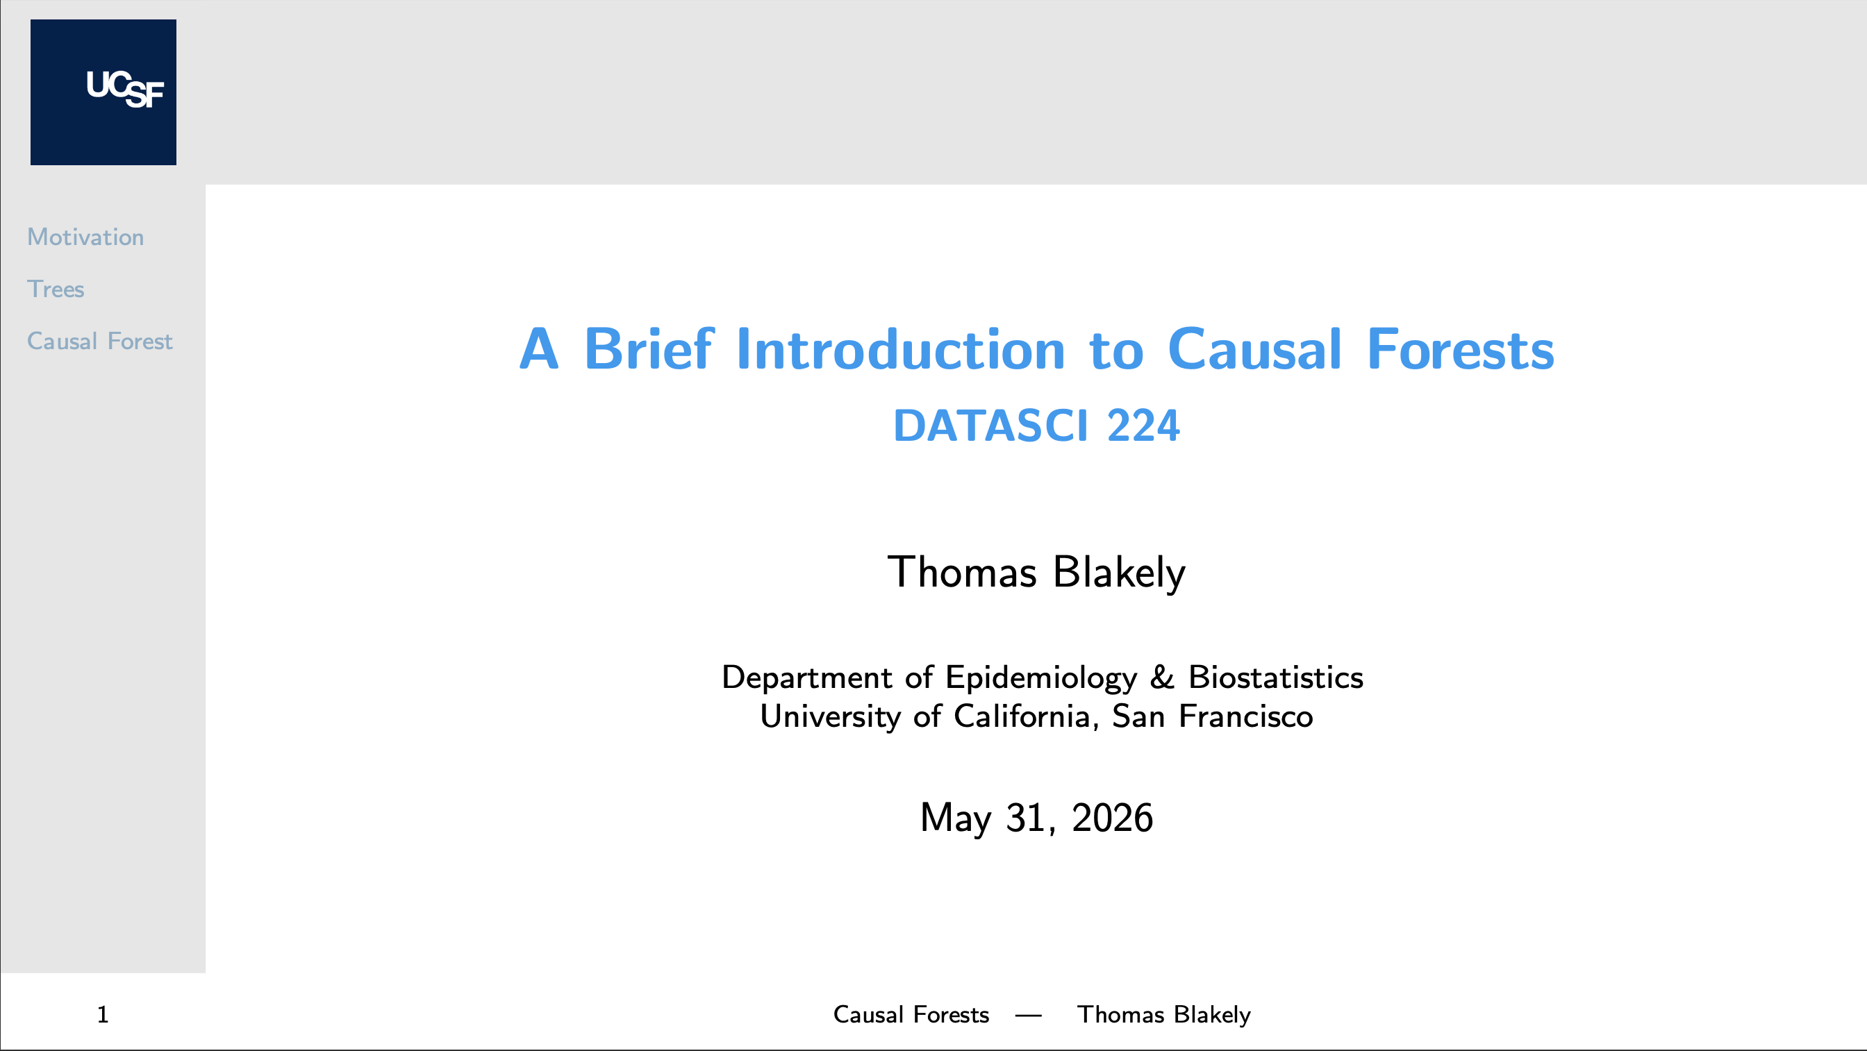
Notes:
Hey there everyone, my name is Thomas Blakely, and I'll be giving a quick presentation on causal forests, which is a machine-learning method that will allow us to estimate how treatment effects vary across patients.

Slide 2
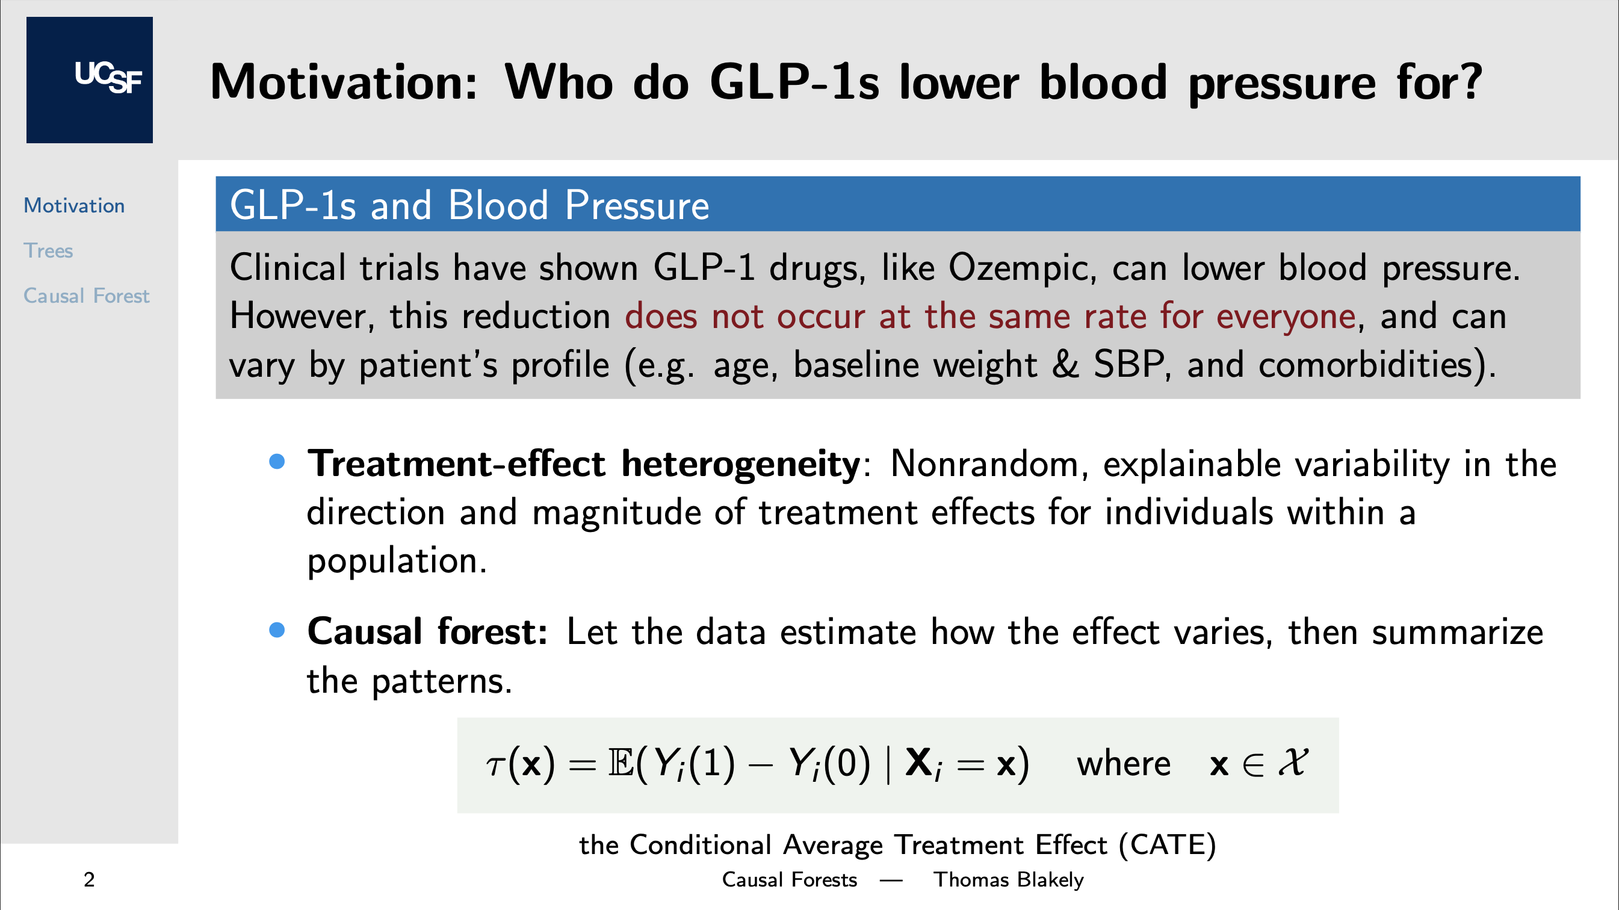
Notes:
My motivation for causal forests comes from my recent work on GLP-1s and their effects on blood pressure. When we deal with medications, one thing we always have to consider is the fact that the effect of a medication is not the same for everyone. In fact, this treatment effect can vary based on baseline characteristics like age, weight, if they have diabetes, and other comorbidities. This naturally leads to the idea of treatment-effect heterogeneity, where we're concerned not just with the average effect of a drug, but for which populations or subgroups it might affect more or less. Formally, that per-patient effect is the conditional average treatment effect, the CATE, and it's what the whole talk is trying to estimate. Now with research, we could pre-specify a specific subgroup analysis, like by obesity status. However, we can also address this through a machine learning approach where we let the data tell us which subgroups differ from one another. This is where causal forests come in.

Slide 3
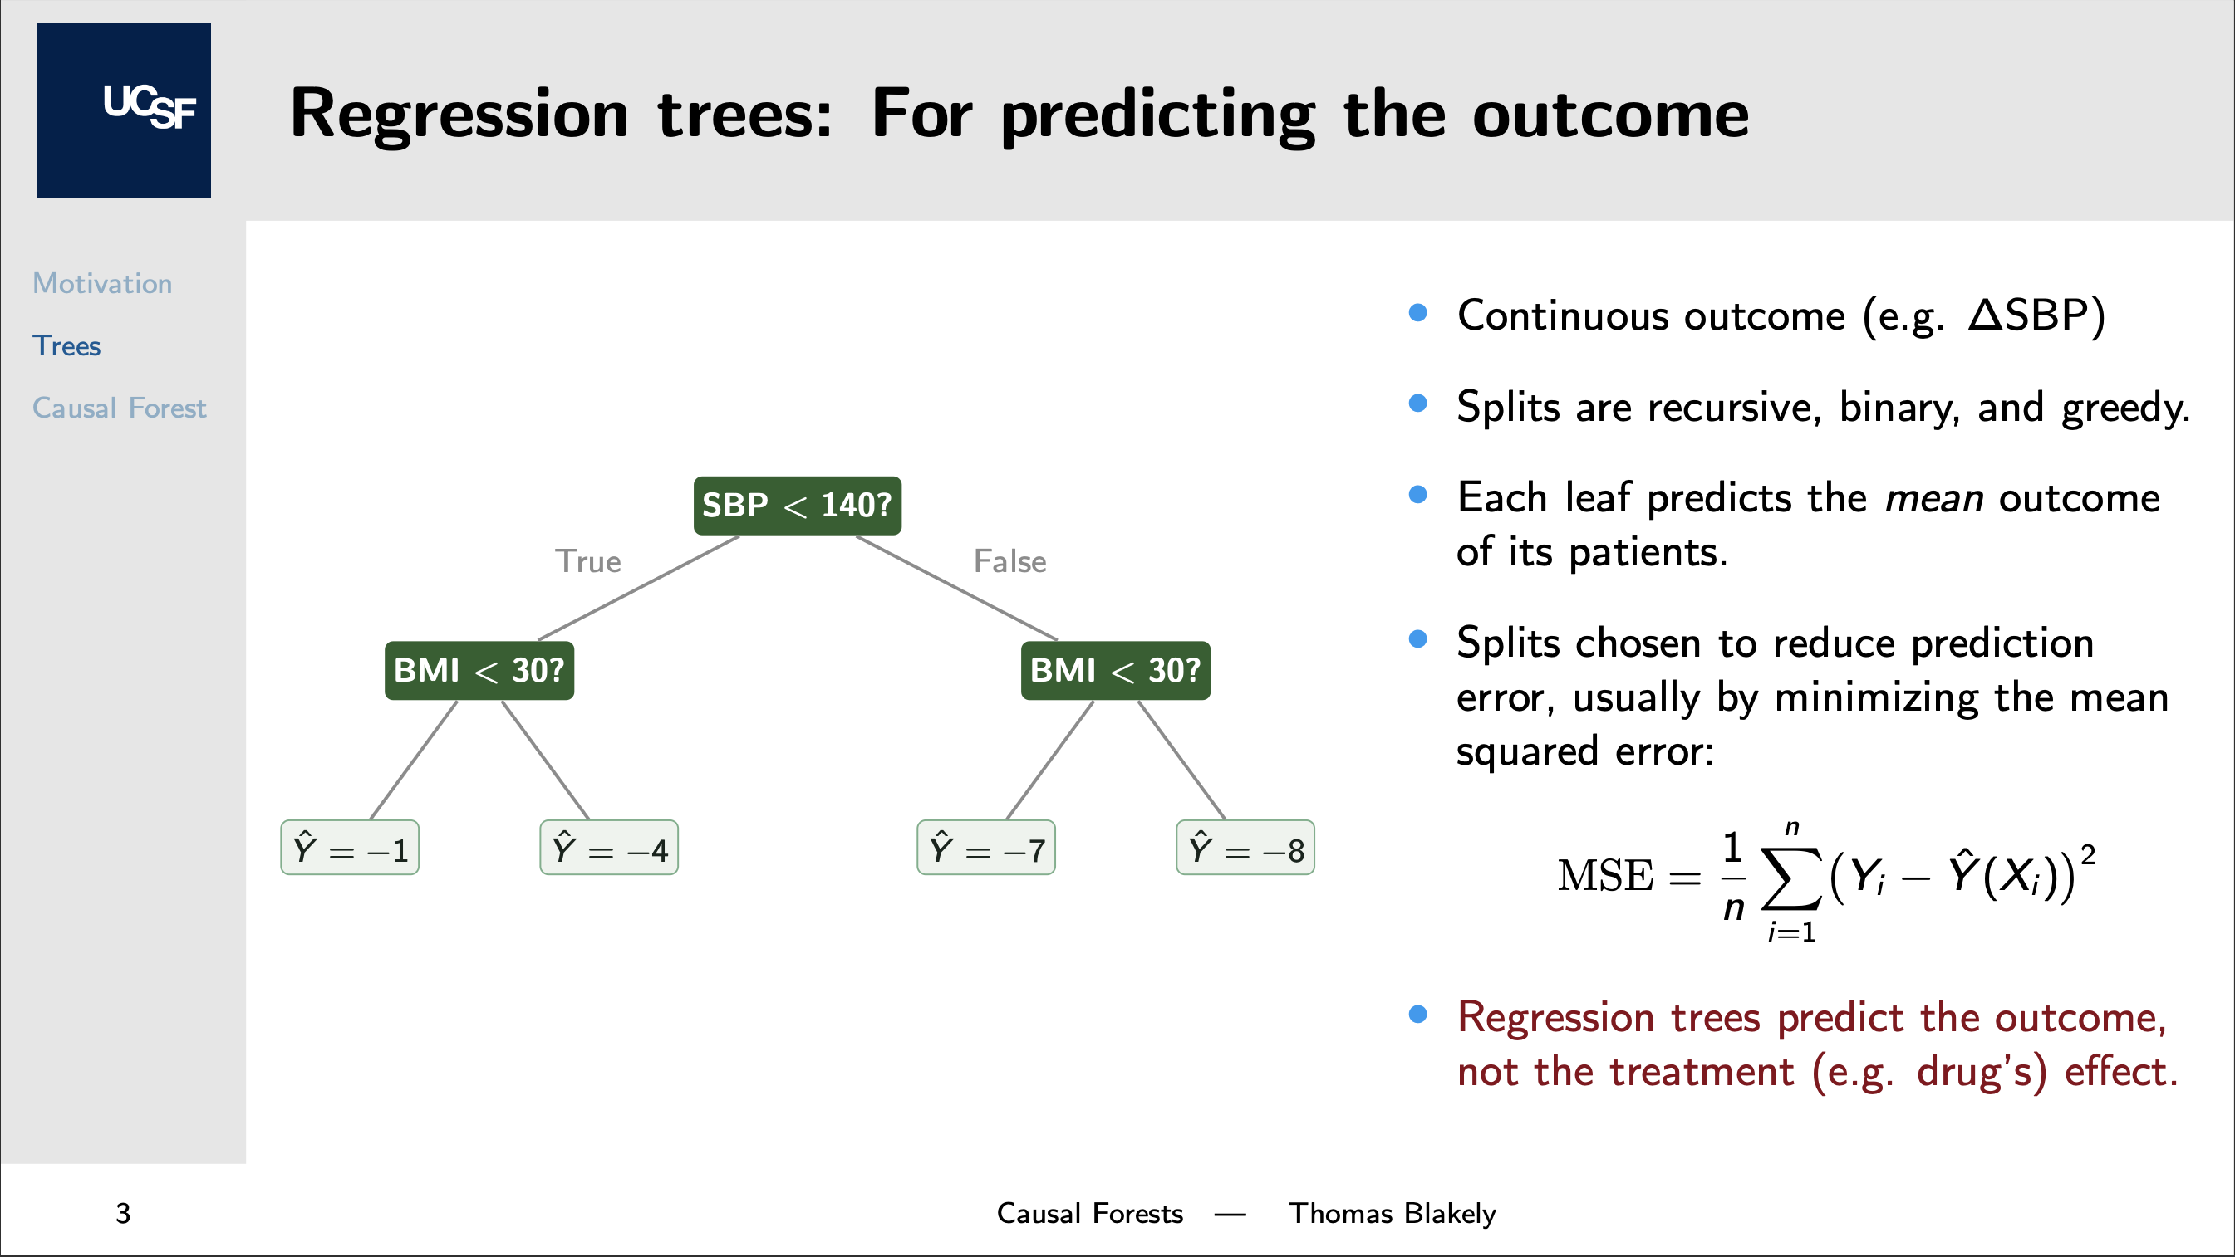
Notes:
However, before getting to causal forests, we need to start with regression trees. Regression trees are similar to the classification trees we covered in week 4, except in this case, the outcome is continuous. With regression trees, the splits are recursive, binary, and greedy. This basically means the tree makes one True-False split at a time, taking the best split available at that step, usually chosen by minimizing the mean squared error, rather than planning far ahead. Here, each leaf predicts the average outcome among the observations in that leaf. Now the key thing to notice here is that regression trees focus on predicting the outcome itself, not estimating a treatment's causal effect. That is the part we are about to change.

Slide 4
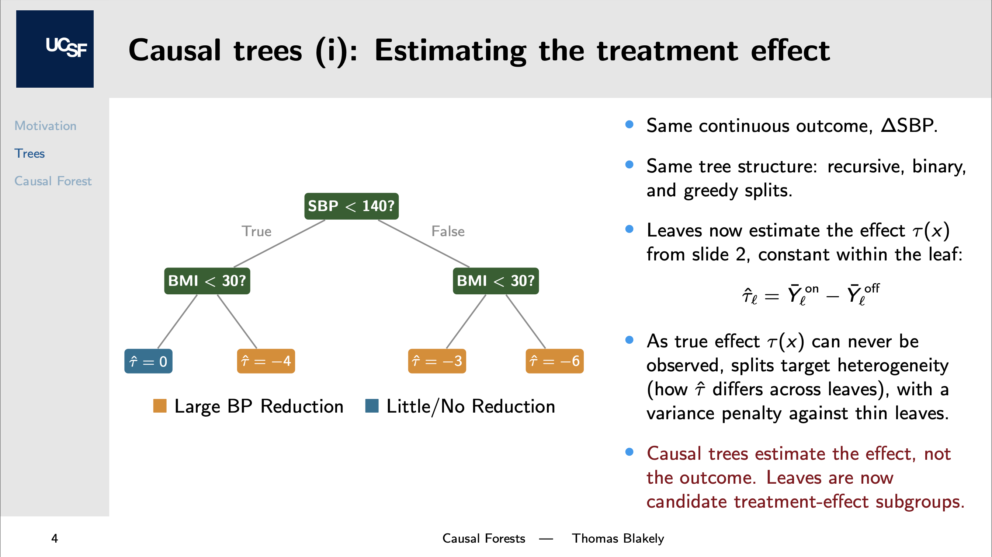
Notes:
With causal trees, we keep the same basic tree structure but change what each leaf represents. For this presentation, we will assume the same splits were chosen. Instead of a predicted outcome, each leaf contains an estimated treatment effect. For example, the average blood-pressure change for patients on a GLP-1 minus the average change for comparable patients not on one, within that subgroup. The splitting rule changes too. Since we never observe both potential outcomes for the same patient, minimizing error against the true individual effect is infeasible. So the tree optimizes an estimable version of that objective: it rewards splits that create meaningful differences in estimated effects across leaves, and penalizes noisy splits based on too little information. The result is a readable tree whose leaves represent candidate treatment-effect subgroups.

Slide 5
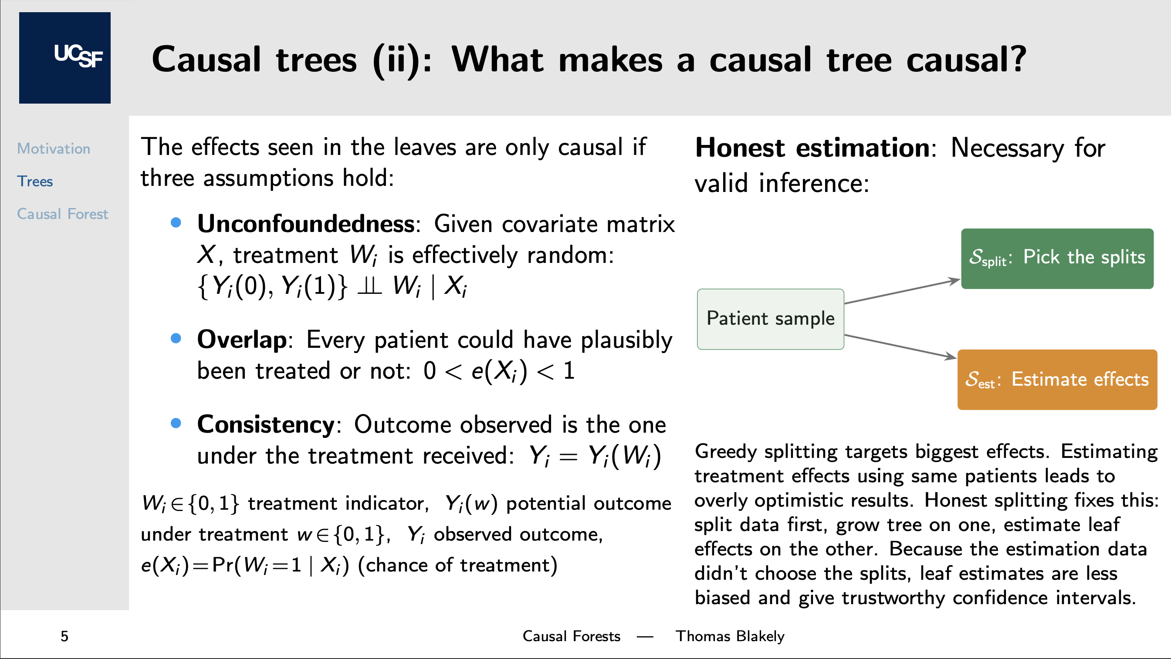
Notes:
So far, based on last slide each leaf is just a difference in average blood-pressure change between treated and untreated patients. Why should we read that difference as the drug's causal effect, and not just a difference between two groups of people? It comes back to the counterfactual problem: since we only observe one treatment state for each patient, we are always comparing treated patients to different untreated patients, and that comparison is only valid under a few assumptions. We need unconfoundedness: after adjusting for observed covariates, treatment assignment is as good as random. We need overlap: for each kind of patient, there is a reasonable chance they could have been treated or untreated. And we need consistency: the observed change is the outcome under the treatment the patient actually received. There is also a fitting problem. Trees are greedy, so they tend to find subgroups where the effect looks extreme, and if we estimate that effect using those same patients, it can come out exaggerated. Honest estimation fixes this by splitting the sample: one part chooses the tree structure, and a separate part estimates the effects within the leaves. That is what makes the confidence intervals more trustworthy.

Slide 6
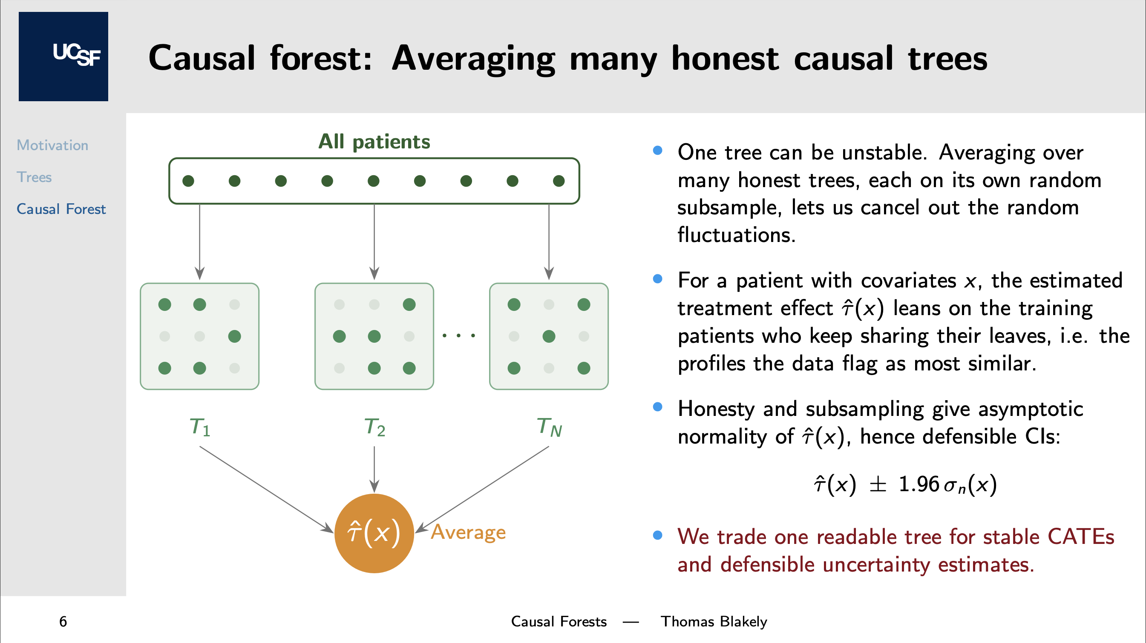
Notes:
Now we go from causal trees to causal forests. While a single tree is interpretable, it's unstable, as small changes in the data can lead to a completely different tree. A causal forest fixes this problem by growing many honest trees, each on a random subsample of the data, and averaging them. The intuition here is that for each patient, those who consistently end up in the same leaves have a greater influence on that patient’s estimated effect. So everyone’s estimate is built from the patients most like them. And because the forest is built from many honest trees on random subsamples, the causal forest estimates behave approximately normally, so we can quantify uncertainty and construct confidence intervals. So by going from a causal tree to a causal forest, we give up a single readable tree for more stable estimates with uncertainty we can defend. And that's what we care about with causal inference anyway; we want reliable, trustworthy estimates, not massive predictive accuracy.
And that is the causal forest: we start with data and a question about treatment-effect heterogeneity, and the forest estimates a conditional treatment effect for each patient, which we can use to identify clinically meaningful patterns. And that is my presentation, thank you!

Slide 7
References
Causal Forests
[1] Wager, S., & Athey, S. (2018). Estimation and inference of heterogeneous treatment effects using random forests. Journal of the American Statistical Association, 113(523), 1228-1242.
[2] Athey, S., & Wager, S. (2019). Estimating treatment effects with causal forests: An application. Observational studies, 5(2), 37-51.
[3] Li, J., Ma, S., Le, T., Liu, L., & Liu, J. (2016). Causal decision trees. IEEE Transactions on Knowledge and Data Engineering, 29(2), 257-271.
Heterogenous Treatment Effects
[4] Varadhan R, Seeger JD. Estimation and Reporting of Heterogeneity of Treatment Effects. In: Velentgas P, Dreyer NA, Nourjah P, et al., editors. Developing a Protocol for Observational Comparative Effectiveness Research: A User's Guide. Rockville (MD): Agency for Healthcare Research and Quality (US); 2013 Jan. Chapter 3. Available from: https://www.ncbi.nlm.nih.gov/books/NBK126188/
[5] Imai, K. (2021). Heterogeneous treatment effects. Harvard University. https://imai.fas.harvard.edu/teaching/files/hetero_effects.pdf
Regression Trees
[6] Steorts, R. C. (2017). Tree Based Methods: Regression trees. Department of Statistical Science, Duke University. https://www2.stat.duke.edu/~rcs46/lectures_2017/08-trees/08-tree-regression.pdf

